Slide 1
THE 12 MINOR PROPHETS
An overview of the timeline

Slide 2
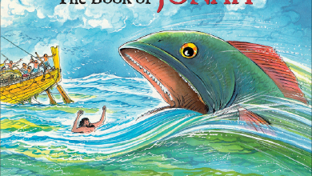
First up: Jonah

Slide 3
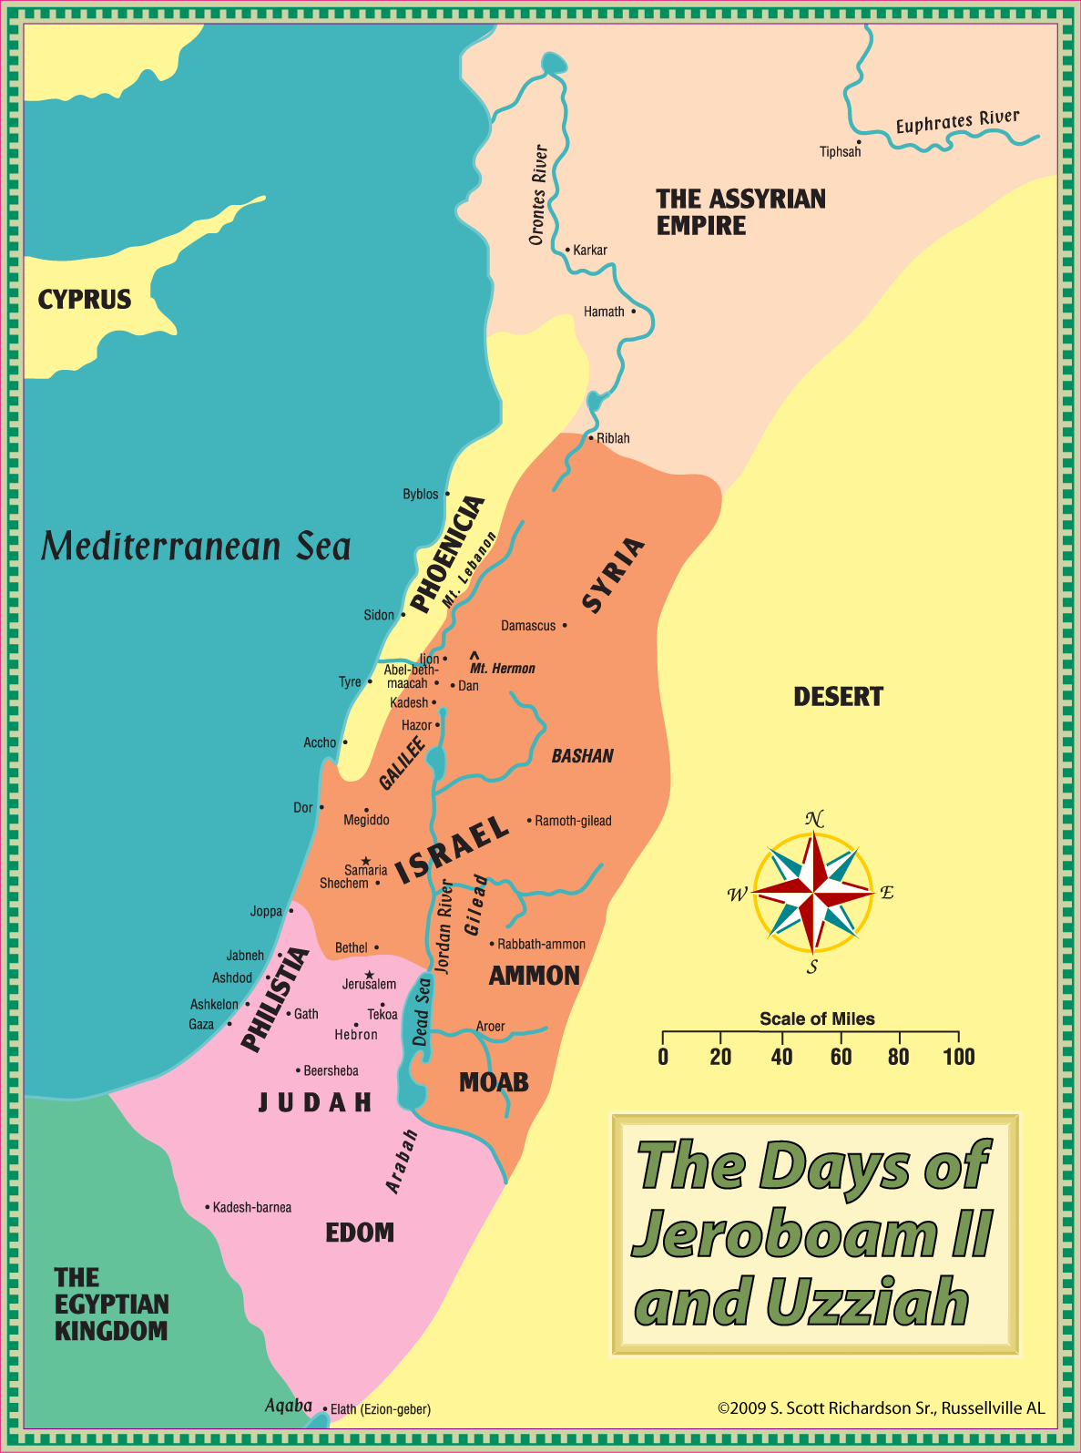
The Cast (WWWWWH)
Jonah
Jeroboam II
The Sailors
Nineveh

Slide 4
The Cast (WWWWWH)
Jonah
Jeroboam II
The Sailors
Nineveh

Slide 5
The Cast (WWWWWH)
Jonah
Jeroboam II
The Sailors
Nineveh

Slide 6
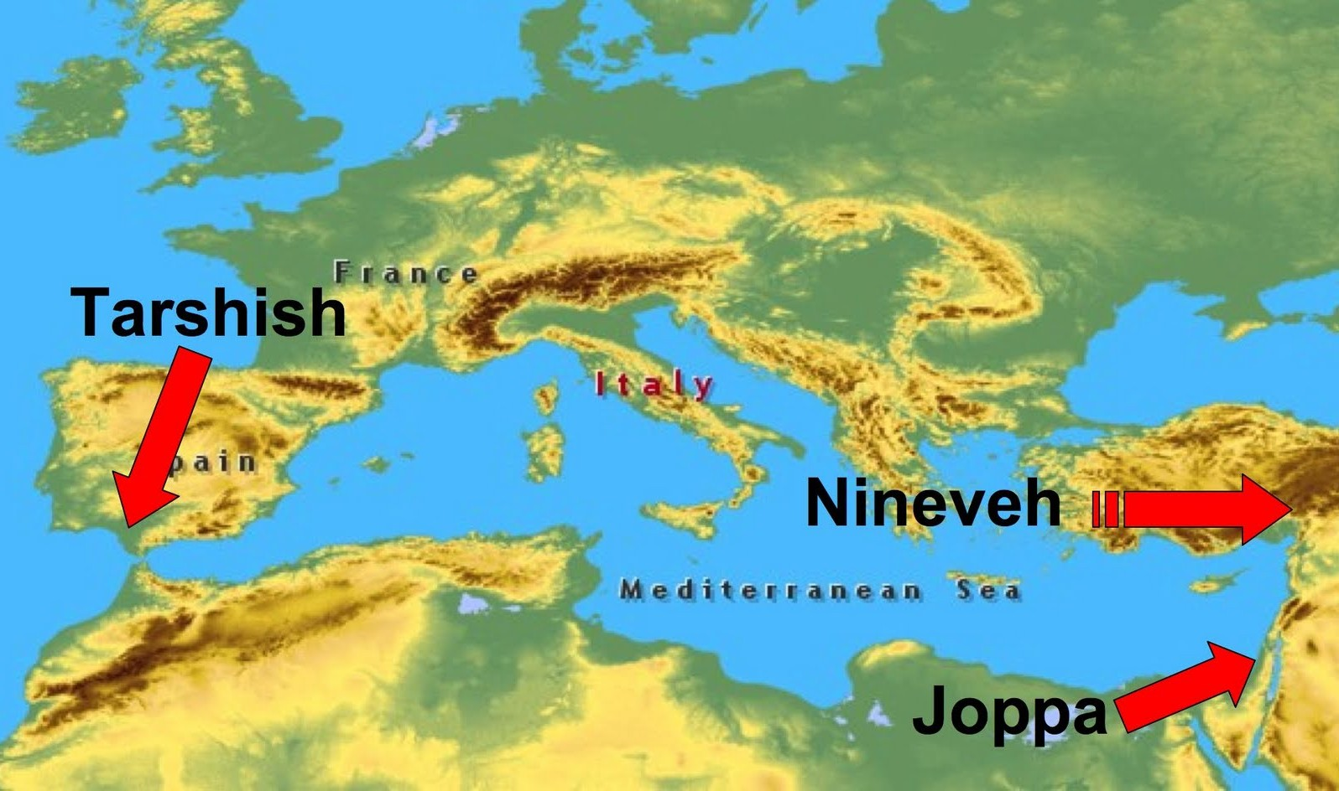

Slide 7
Kingdom Split
930 BC
Book of Jonah
Northern Kingdom Overthrown
722 BC
Set in the reign of Jeroboam II

Slide 8
Book of Jonah Breakdown
Chapter 1: non-Israelite sailors (true worship of God)
Chapter 2: Jonah’s prayer (sort of)
Chapter 3: non-Israelite Ninevites (true worship of God)
Chapter 4: Jonah’s prayer (sort of)

Slide 9
Matthew 12:38-41 (The Desire for Signs)
38 Then some of the scribes and Pharisees said to Him, “Teacher, we want to see a sign from You.” 39 But He answered and said to them, “An evil and adulterous generation craves a sign; and so no sign will be given to it except the sign of Jonah the prophet; 40 for just as Jonah was in the stomach of the sea monster for three days and three nights, so will the Son of Man be in the heart of the earth for three days and three nights. 41 The men of Nineveh will stand up with this generation at the judgment, and will condemn it because they repented at the preaching of Jonah; and behold, something greater than Jonah is here.

Slide 10
Matthew 16:4
4 An evil and adulterous generation wants a sign; and so a sign will not be given to it, except the sign of Jonah.” And He left them and went away.

Slide 11
Luke 11:29-32
²⁹ Now as the crowds were increasing, He began to say, “This generation is a wicked generation; it demands a sign, and so no sign will be given to it except the sign of Jonah. ³⁰ For just as Jonah became a sign to the Ninevites, so will the Son of Man be to this generation. ³¹ The Queen of the South will rise up with the men of this generation at the judgment and condemn them, because she came from the ends of the earth to listen to the wisdom of Solomon; and behold, something greater than Solomon is here. ³² The men of Nineveh will stand up with this generation at the judgment and condemn it, because they repented at the preaching of Jonah; and behold, something greater than Jonah is here.

Slide 12
Listen for this:
Specific Directions to a Specific Audience

Slide 13
Jonah 1
1 The word of the Lord came to Jonah the son of Amittai, saying,
2 “Arise, go to Nineveh, the great city, and cry out against it, because their wickedness has come up before Me.”
3 But Jonah got up to flee to Tarshish from the presence of the Lord. So he went down to Joppa, found a ship that was going to Tarshish, paid the fare, and boarded it to go with them to Tarshish away from the presence of the Lord.

Slide 14
Jonah 1
⁴ However, the Lord hurled a great wind on the sea and there was a great storm on the sea, so that the ship was about to break up.
⁵ Then the sailors became afraid and every man cried out to his god, and they hurled the cargo which was in the ship into the sea to lighten it for them. But Jonah had gone below into the stern of the ship, had lain down, and fallen sound asleep.
⁶ So the captain approached him and said, “How is it that you are sleeping? Get up, call on your god! Perhaps your god will be concerned about us so that we will not perish.”

Slide 15
Jonah 1
⁷ And each man said to his mate, “Come, let’s cast lots so that we may find out on whose account this catastrophe has struck us.” So they cast lots, and the lot fell on Jonah.
⁸ Then they said to him, “Tell us, now! On whose account has this catastrophe struck us? What is your occupation, and where do you come from? What is your country, and from what people are you?”
⁹ So he said to them, “I am a Hebrew, and I fear the Lord God of heaven who made the sea and the dry land.”

Slide 16
Jonah 1
¹⁰ Then the men became extremely afraid, and they said to him, “How could you do this?” For the men knew that he was fleeing from the presence of the Lord, because he had told them.

Slide 17
Jonah 1
¹¹ So they said to him, “What should we do to you so that the sea will become calm for us?”—for the sea was becoming increasingly stormy.
¹² And he said to them, “Pick me up and hurl me into the sea. Then the sea will become calm for you, because I know that on account of me this great storm has come upon you.”

Slide 18
Jonah 1
¹³ However, the men rowed desperately to return to land, but they could not, because the sea was becoming even stormier against them.
¹⁴ Then they cried out to the Lord and said, “We earnestly pray, O Lord, do not let us perish on account of this man’s life, and do not put innocent blood on us; for You, Lord, have done as You pleased.”

Slide 19
Jonah 1
¹⁵ So they picked up Jonah and hurled him into the sea, and the sea stopped its raging.
¹⁶ Then the men became extremely afraid of the Lord, and they offered a sacrifice to the Lord and made vows.
¹⁷ And the Lord designated a great fish to swallow Jonah, and Jonah was in the stomach of the fish for three days and three nights.

Slide 20
Next Week: Jonah’s Response
Sort of a Prayer

